Slide 1


Dan Marks
December 26, 2023

Slide 2

Outline
Executive Summary
Introduction
Methodology
Results
Conclusion
Appendix

Slide 3
Executive Summary
Methodologies
Data collection via REST API calls and webscraping, storage in SQL DB
Data wrangling in Pandas data frame and EDA with SQL
Additional Visualization with Plotly & Folium
Predictive analysis using ML classification models (Scikit learn)
Summary of results
The models predict with fairly high certainty, based on the parameters provided, the success of any given mission based on the payload mass, type of orbit, and other input features. Logistic Regression selected.
The cost per successful mission is the quotient of the total cost (for all missions) and the number of successful missions.

Slide 4
Introduction
The commercial space age is here, companies are making space travel affordable for everyone
SpaceX has reduced costs significantly by reusing first-stage launch components
SpaceX launch costs are ~$62M; other are upwards of ~$165M
Goals:
Determine if the first stage will land based on launch data
Determine the cost of a launch.
Approach:
Use Machine Learning to predict success of a given launch (and thus the reuse of components)
Aggregate data to determine per-launch costs

Slide 5

Section 1

Slide 6
Methodology
Executive Summary
Data collection methodology:
Data frames read from SpaceX Launch Data API and scraped from SpaceX Wikipedia page
Perform data wrangling
Data frames in pandas were analyzed and manipulated to clean, transform, load data into SQL DB
Perform exploratory data analysis (EDA) using visualization and SQL
Perform interactive visual analytics using Folium and Plotly Dash
Perform predictive analysis using classification models
Scikit-learn utilized on transformed Pandas data frames and data series

Slide 7
Data Collection
Data frames read from SpaceX Launch Data API
https://api.spacexdata.com/v4/launches/past
Utilized Python ‘requests’ package for REST calls
Response text converted from JSON file and converted to Pandas data frame
Additional data scraped from SpaceX Wikipedia page
https://en.wikipedia.org/w/index.php?title=List_of_Falcon_9_and_Falcon_Heavy_launches
Utilized Python ‘requests’ package and ‘BeautifulSoup’ (bs4) packages
Parsed table information using bs4 methods

Slide 8
Data Collection – SpaceX API
GitHub URL of the completed SpaceX API calls notebook:
https://github.com/dmarks84/IBM-DS-Capstone/blob/main/1%20Data%20Collection%20API.ipynb
GET (JSON data)
requests.get(spacex launch url)
CONVERT JSON
response.json()
NORMALIZE
pd.json_normalize(response)
INITIAL TRANSFORMATION
Multiple Pandas data frame manipulations
CONVERT TO CSV
pd.to_csv(df)

Slide 9
Data Collection - Scraping
GitHub URL of the completed webscraping notebook:
https://github.com/dmarks84/IBM-DS-Capstone/blob/main/2%20Webscraping.ipynb
GET (html data)
requests.get(spacex launch wiki)
CONVERT TO BS4 OBJECT
BeautifulSoup(response.text)
FIND TABLE DATA
soup.find_all(‘table’)
FIND LAUNCH ROWS
soup_table.find_all(‘th’)
FIND LAUNCH DATA
soup_table.row_all(‘tr’)
CONVERT TO CSV
pd.to_csv(df)

Slide 10
Data Wrangling
Data was reviewed for missing/null values and for data types
Data was reviewed by launch site, orbit type, and mission success to identify meaningful metrics
Class feature was engineered to record success of failure of each launch
Data stored in SQL Database
GitHub URL of the completed data wrangling notebook:
https://github.com/dmarks84/IBM-DS-Capstone/blob/main/3%20Data%20Wrangling.ipynb

Slide 11
EDA with SQL
Example SQL queries utilized and results:
GitHub URL of the completed EDA notebook:
https://github.com/dmarks84/IBM-DS-Capstone/blob/main/4%20EDA%20%26%20SQL.ipynb
Query | Result
SELECT SUM("PAYLOAD_MASS__KG_") FROM SPACEXTABLE WHERE "Customer" = "NASA (CRS)" | Total payload mass carried by boosters launched by NASA
SELECT MIN("Date") AS "First Successful Landing" FROM SPACEXTABLE WHERE "Landing_Outcome" LIKE "Success%" | Data of first successful landing outcome
SELECT "Landing_Outcome", COUNT("Landing_Outcome") AS "Count" FROM SPACEXTABLE WHERE ((substr("Date",0,5)*365 + substr("Date",6,2)*12 + substr("Date",9,2)) BETWEEN (2010*365+6*12+4) AND (2017*365+3*12+20)) GROUP BY "Landing_Outcome" ORDER BY COUNT("Landing_Outcome") DESC | Count of landing outcomes between the date 2010-06-04 and 2017-03-20.

Slide 12
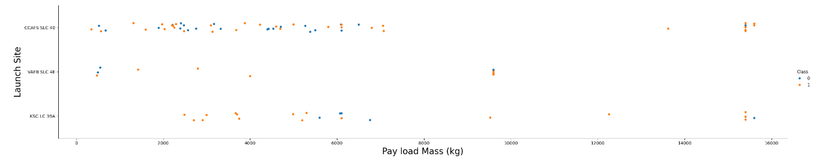
EDA with Data Visualization
Visualizations focused on success of missions based on pairs of parameters.
Example given: Success of Missions for Launch Site vs. Payload mass:
GitHub URL of the completed EDA notebook:
https://github.com/dmarks84/IBM-DS-Capstone/blob/main/5%20EDA%20%26%20Data%20Visualization.ipynb

Slide 13
Build an Interactive Map with Folium
Objects created and their purpose:
Circles – Identify locations of launch sites
Markers – Individual launches and nearby landmarks
Clusters – Group launches together by mission success
Lines – Visualize distances between markers
GitHub URL of the completed map notebook:
https://github.com/dmarks84/IBM-DS-Capstone/blob/main/5%20EDA%20%26%20Data%20Visualization.ipynb

Slide 14
Build a Dashboard with Plotly Dash
Graphs/interactions and their purpose:
Dropdown – Allow selection of all launches from all launch sites, or filter by launch sites
Range Selector – Allow filter by payload range
Pie Chart – Show percentages of successful missions
Scatter Plot – Show mission success as a function of payload and launch site
GitHub URL of the completed dashboard python (Plotly Dash) code:
https://github.com/dmarks84/IBM-DS-Capstone/blob/main/5%20EDA%20%26%20Data%20Visualization.ipynb

Slide 15
Predictive Analysis (Classification)
Data scaled prior to model creation
Various models were fitted and trained on the data, splitting among training and testing sets, and performing a GridSearch on relevant parameters:
Logistic Regression, Support Vector Machine, Decision Tree, and K-Nearest Neighbor
Models were scored and confusion matrix generated
Model selected with the highest score on testing data
GitHub URL of the completed machine learning model evaluation notebook:
https://github.com/dmarks84/IBM-DS-Capstone/blob/main/8%20Machine%20Learning.ipynb

Slide 16
Results
EDA showed that:
Success rate is correlated with the launch site and payload mass
The likelihood of mission success has also increased with time
See following slides for this and interactive dashboard demo
Predictive analysis results
Results showed that all models performed equally well. Logistic Regression Model selected.
The models predict with fairly high certainty, based on the parameters provided, the success of any given mission based on the payload mass, type of orbit, and other input features
The cost per successful mission is the quotient of the total cost (for all missions) and the number of successful missions.

Slide 17

Section 2

Slide 18
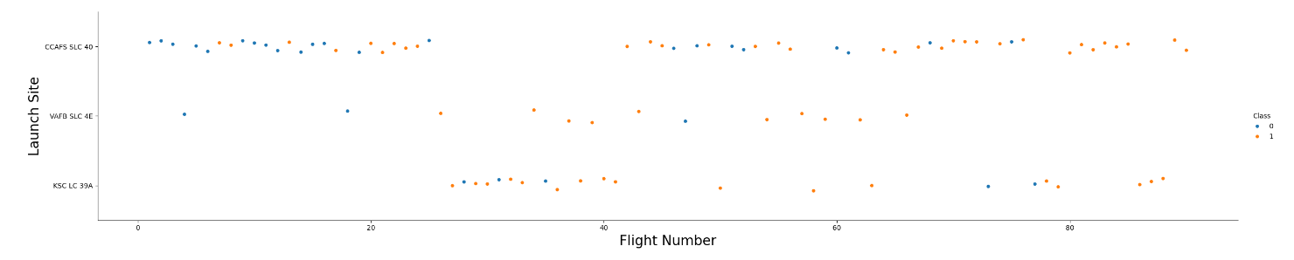
Flight Number vs. Launch Site
Flight Number vs. Launch Site
For all launch sites, the mission success tends to increases with the flight number

Slide 19
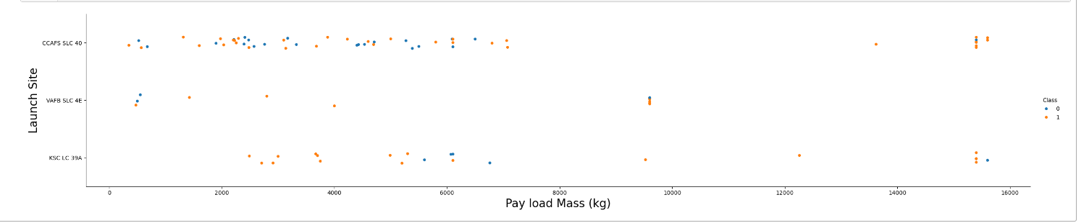
Payload vs. Launch Site
Payload vs. Launch Site
Mission success tends to increase with payload, but the VAFB site has not done any large-payload launches

Slide 20
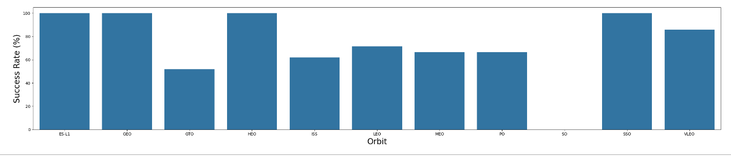
Success Rate vs. Orbit Type
Success for orbit type

Slide 21
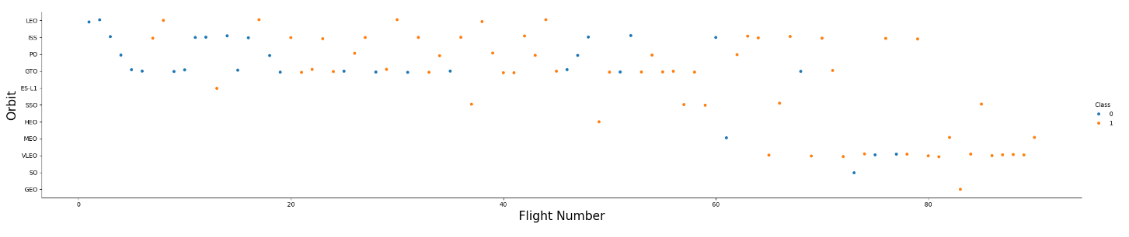
Flight Number vs. Orbit Type
Flight number vs. Orbit type

Slide 22
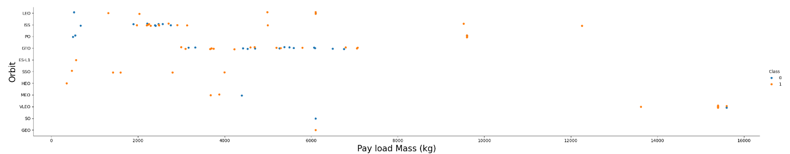
Payload vs. Orbit Type
Payload vs. Orbit type
Show the screenshot of the scatter plot with explanations

Slide 23
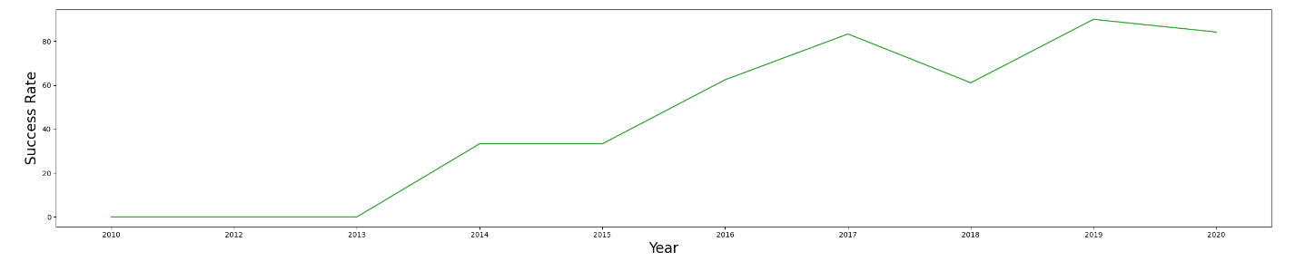
Launch Success Yearly Trend
Yearly Ave Success Rate
Show the screenshot of the scatter plot with explanations

Slide 24
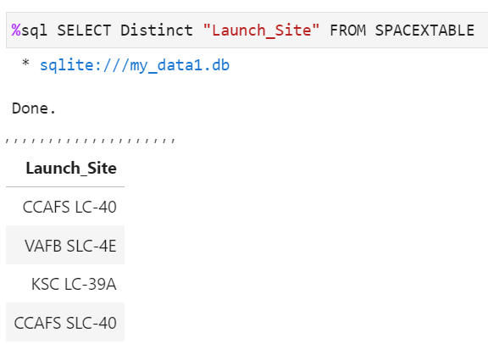
All Launch Site Names

Slide 25
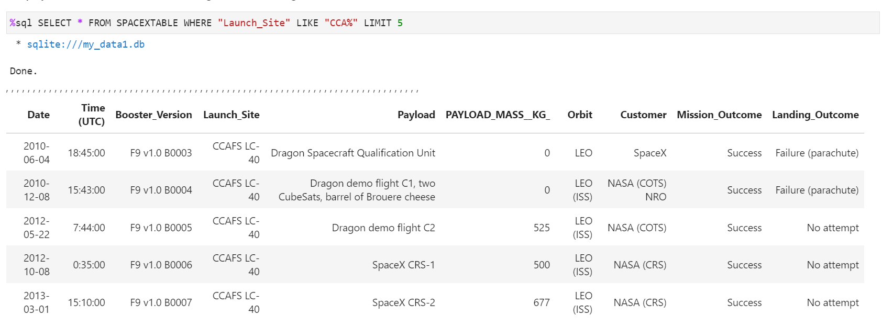
Launch Site Names Begin with 'CCA'

Slide 26
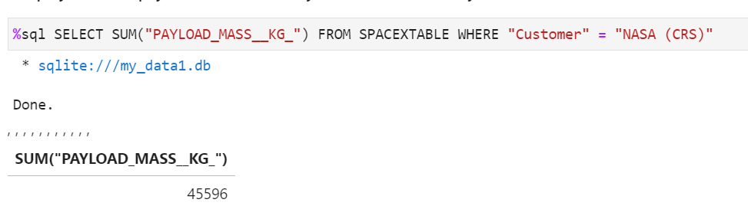
Total Payload Mass

Slide 27
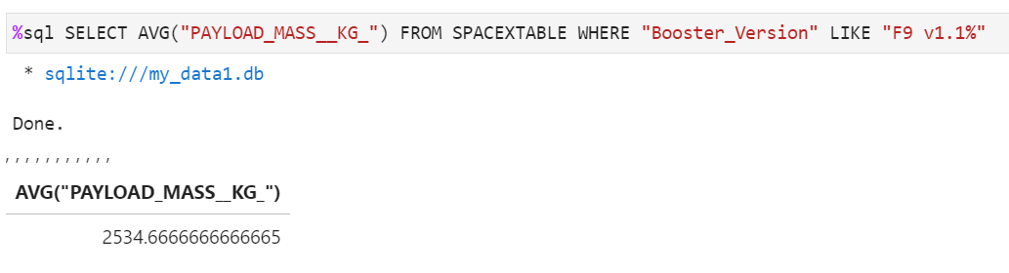
Average Payload Mass by F9 v1.1

Slide 28
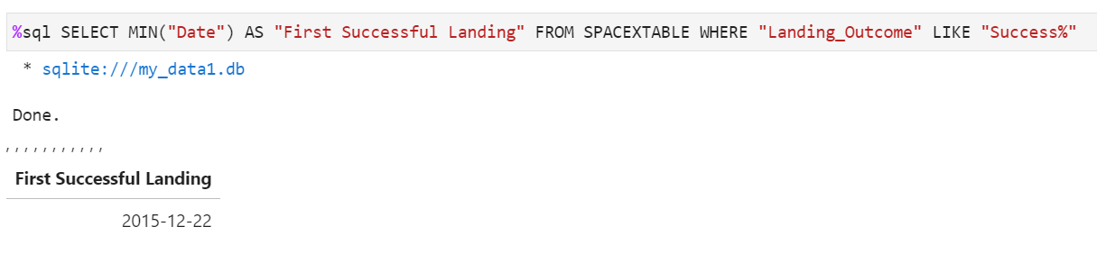
First Successful Ground Landing Date

Slide 29
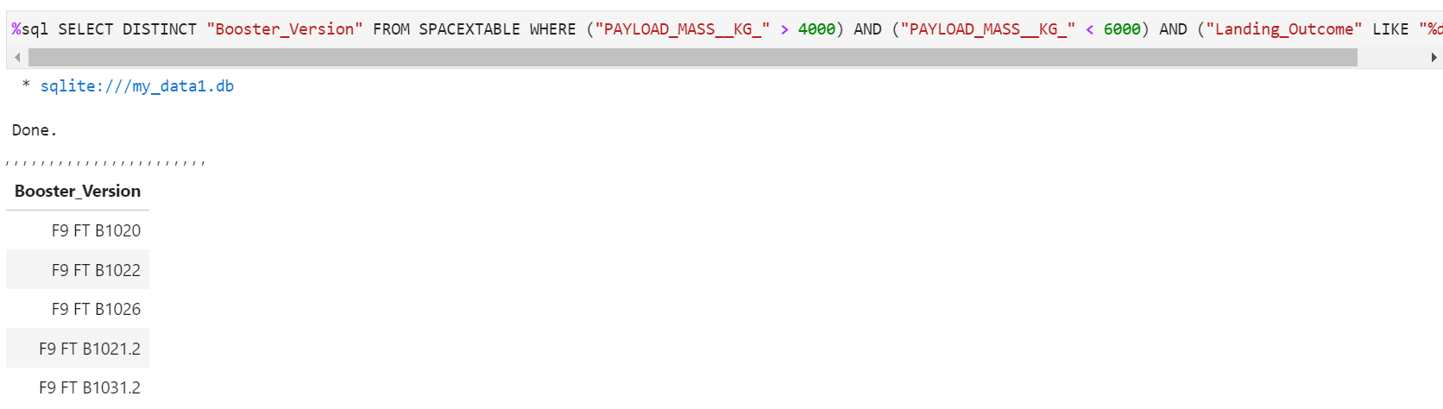
Successful Drone Ship Landing with Payload between 4000 and 6000

Slide 30
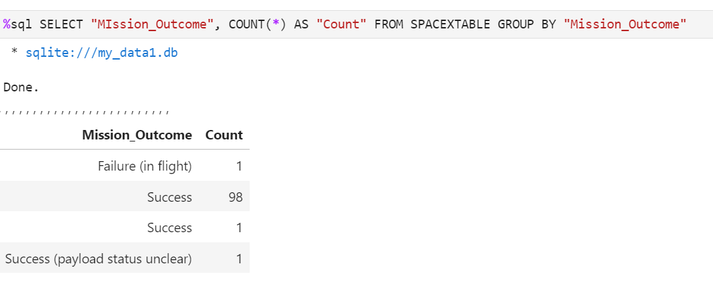
Total Number of Successful and Failure Mission Outcomes

Slide 31
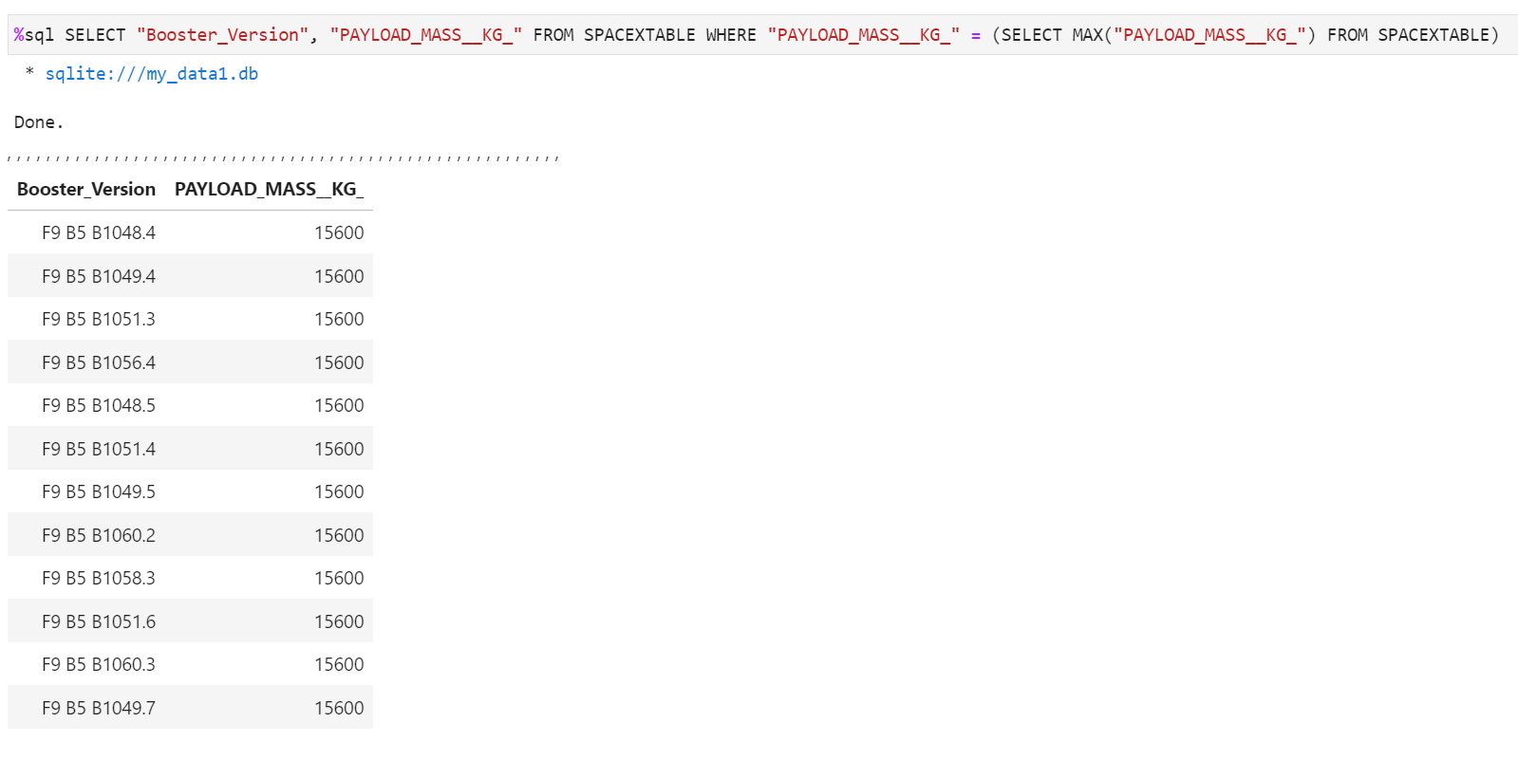
Boosters Carried Maximum Payload

Slide 32
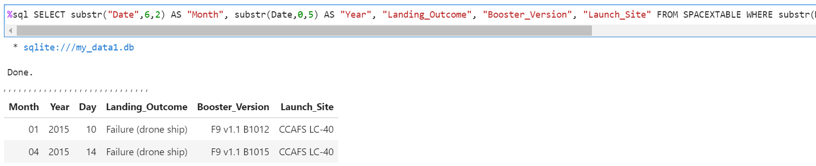
2015 Launch Records

Slide 33
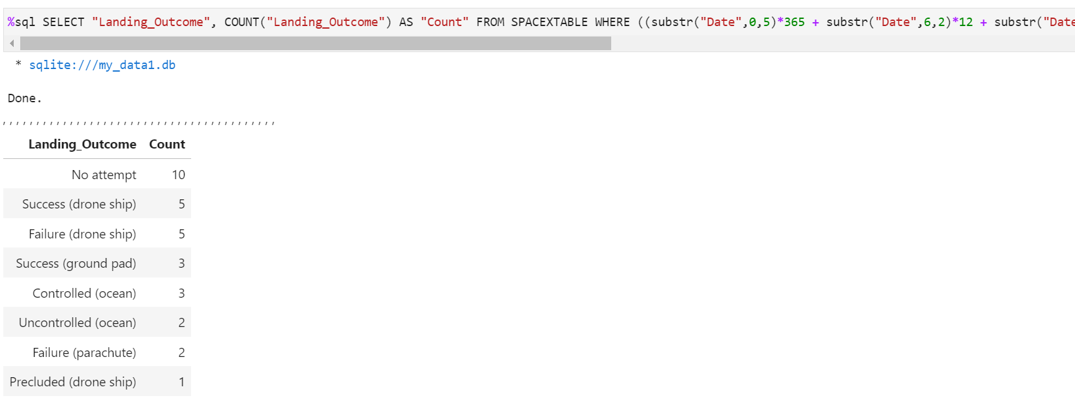
Rank Landing Outcomes Between 2010-06-04 and 2017-03-20
Rank the count of landing outcomes (such as Failure (drone ship) or Success (ground pad)) between the date 2010-06-04 and 2017-03-20, in descending order
Present your query result with a short explanation here

Slide 34

Section 3

Slide 35
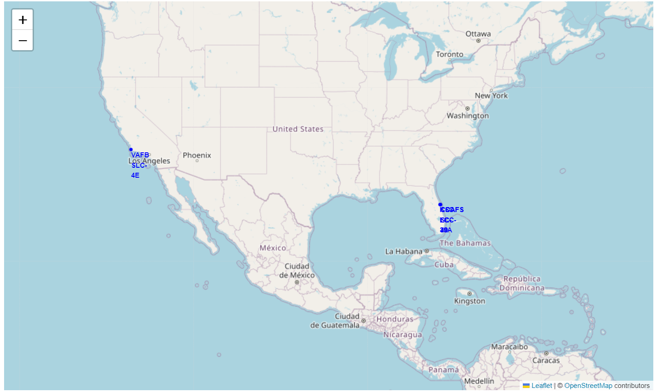
All Launch Sites

Slide 36
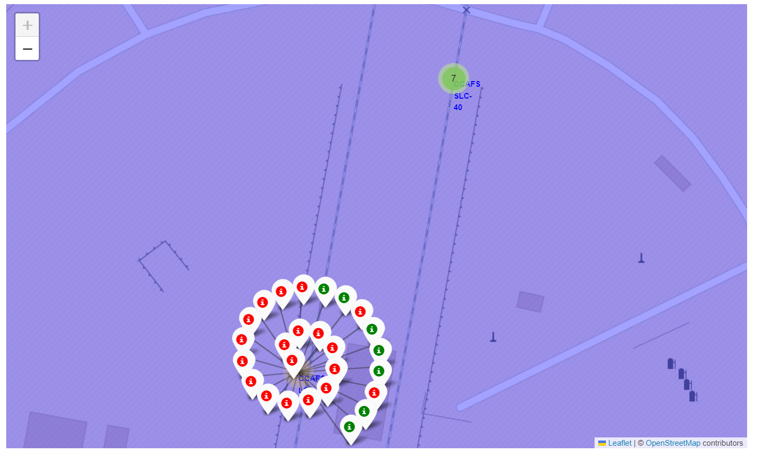
Color-Labeled Launch Outcome Map
This is for the CCAFS LC-40 Launch Site

Slide 37
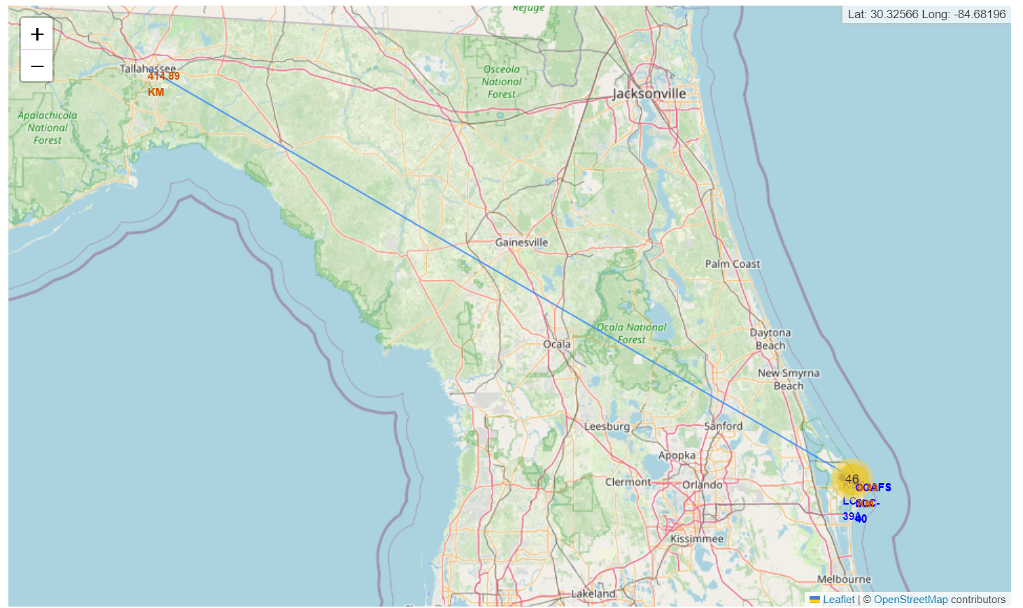
Florida Launch Site Proximate to State Capitol
The exact distance displayed is of the CCAFS LC-40 Launch Site

Slide 38

Section 4

Slide 39
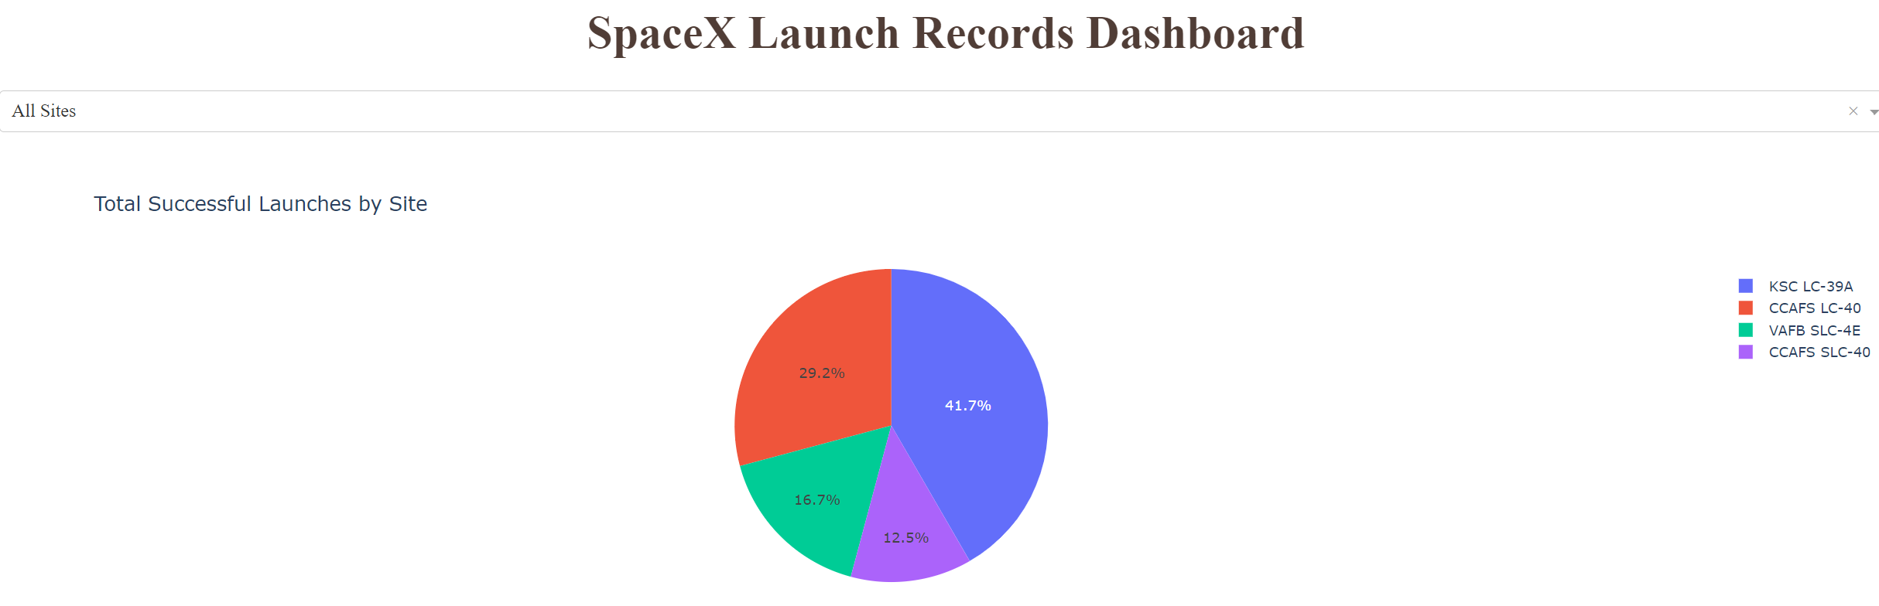
SpaceX Launch Success by Site
KSC LC-39A is the most consistent site, followed by (in order) CCAFS LC-40, VAFB SLC-4E, and CCAGS SLC-40

Slide 40
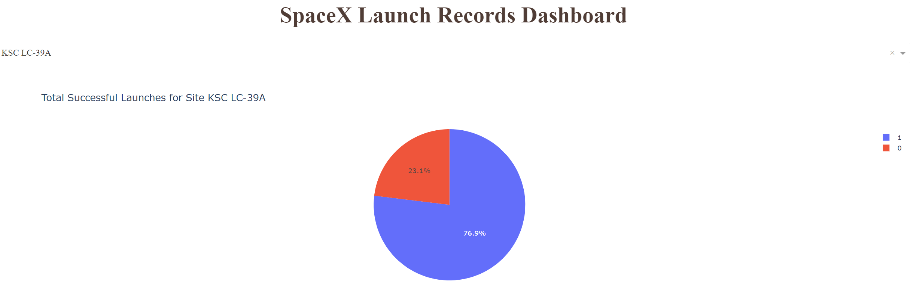
SpaceX Launch Success at KSC LC-39A
KSC LC-39A has a success rate of 76.9%

Slide 41
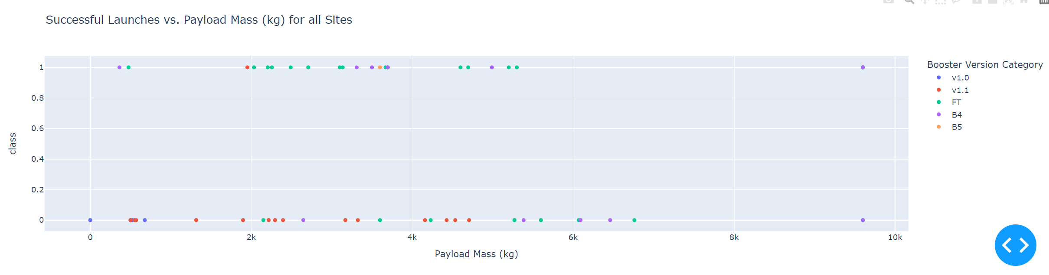
SpaceX Launch Success at KSC LC-39A
The F9 FT has a high success rate and numerous launches
V1.0 and v1.1 have low success rates, and B4 and B5 have moderate or high success rates but relatively few luanches

Slide 42

Section 5

Slide 43
Classification Accuracy
All models displayed the same accuracy score

Slide 44
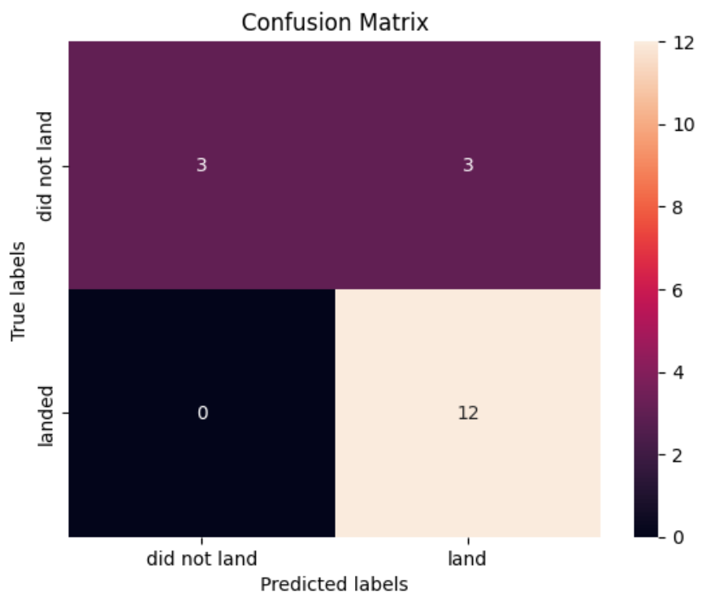
Confusion Matrix
The model had no false positives but a few false negatives. It was very good at predicting landings but less good at predicting if it did not land

Slide 45
Conclusions
The EDA and dashboards can be used to visualize how different relevant features correspond to one another and to the success of the missions they represent.
The models predict with fairly high certainty, based on the parameters provided, the success of any given mission based on the payload mass, type of orbit, and other input features
The cost per successful mission is the quotient of the total cost (for all missions) and the number of successful missions.

Slide 46
Appendix
All relevant information has also been included in the GitHub Repository listed here:
https://github.com/dmarks84/IBM-DS-Capstone

Slide 47


